Slide 1










ATAI
Advanced Technique of Artificial Intelligence
ATAI
ChongqingUniversity _{AdvancedTechniqueof}
of Technology Artificial Intelligence
Chongqing University of
Technology
Chongqing University ^{ATAI}
_{of Technology} Advanced Techniqueof
Artificial Intelligence
Chongqing University of Technology
Chongqing University of Technology
Customizing In-context Learning for Dynamic Interest Adaption in
LLM-based Recommendation
Code:https://github.com/ym689/rec_icl
——ACL_2025
Reported by Long Zhang
1

Slide 2
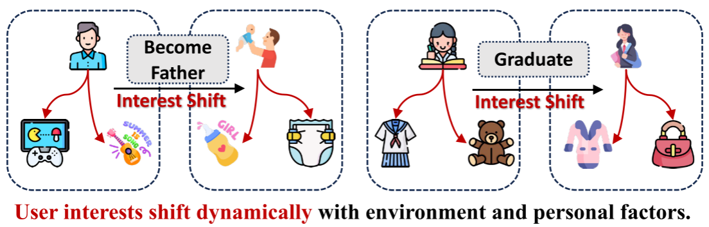
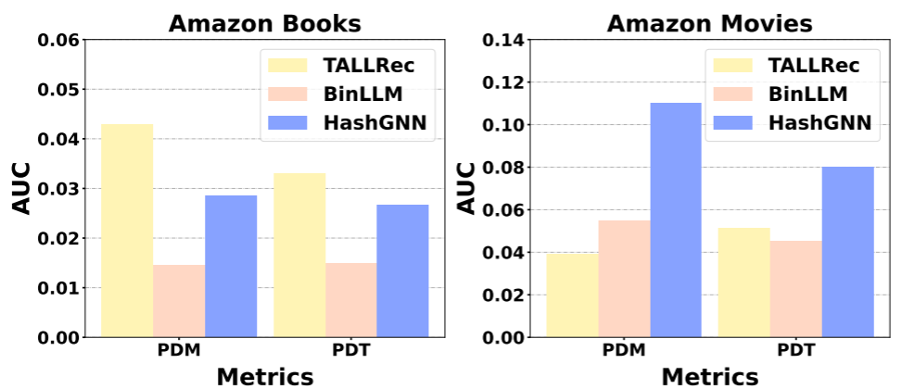
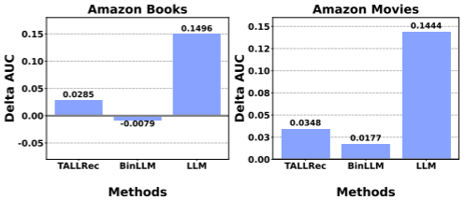
ATAI
Advanced Technique of Artificial Intelligence
ATAI
ChongqingUniversity _{AdvancedTechniqueof}
of Technology Artificial Intelligence
Chongqing University of
Technology
Chongqing University ^{ATAI}
_{of Technology} Advanced Techniqueof
Artificial Intelligence
Chongqing University of Technology
Chongqing University of Technology
Motivation
In order to adapt to the dynamic changes of user interest, the recommendation system based on LLM needs to be updated regularly.
1) However, due to the large number of LLM parameters, model- level updates will bring extremely high computational and time costs.
2) Applying ICL on general LLMs : Lacking alignment with recommendation tasks.
3) Applying ICL on LLMs tuned for recommendations: often suffers from diminished ICL capabilities.

Slide 3
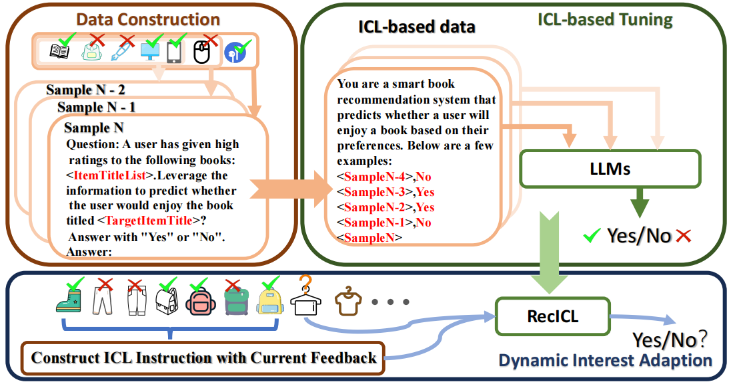
ATAI
Advanced Technique of Artificial Intelligence
ATAI
ChongqingUniversity _{AdvancedTechniqueof}
of Technology Artificial Intelligence
Chongqing University of
Technology
Chongqing University ^{ATAI}
_{of Technology} Advanced Techniqueof
Artificial Intelligence
Chongqing University of Technology
Chongqing University of Technology
Method

Slide 4
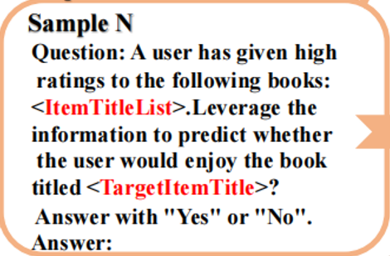
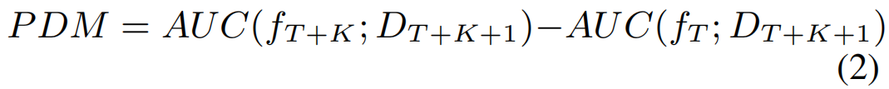
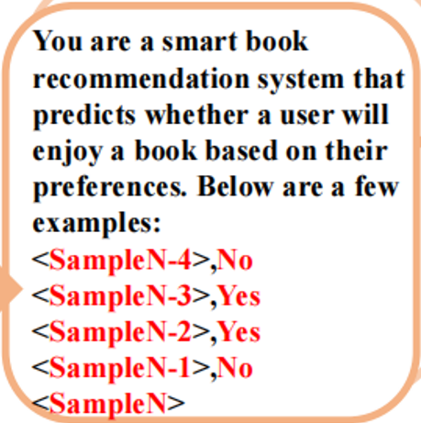
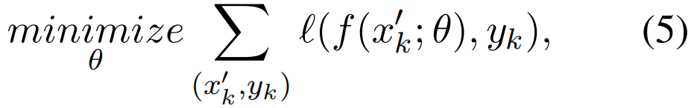
ATAI
Advanced Technique of Artificial Intelligence
ATAI
ChongqingUniversity _{AdvancedTechniqueof}
of Technology Artificial Intelligence
Chongqing University of
Technology
Chongqing University ^{ATAI}
_{of Technology} Advanced Techniqueof
Artificial Intelligence
Chongqing University of Technology
Chongqing University of Technology
Method

Slide 5
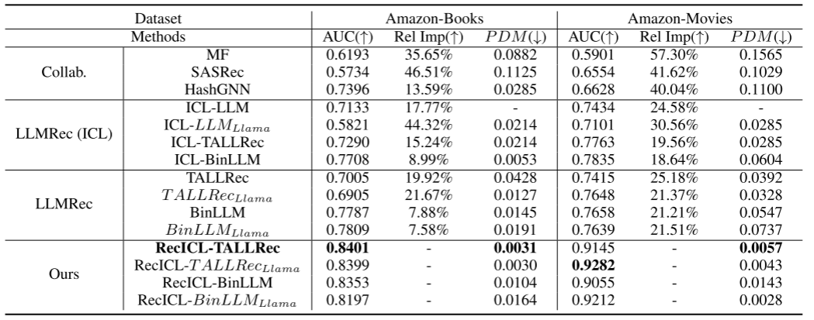
ATAI
Advanced Technique of Artificial Intelligence
ATAI
ChongqingUniversity _{AdvancedTechniqueof}
of Technology Artificial Intelligence
Chongqing University of
Technology
Chongqing University ^{ATAI}
_{of Technology} Advanced Techniqueof
Artificial Intelligence
Chongqing University of Technology
Chongqing University of Technology
Experiments

Slide 6
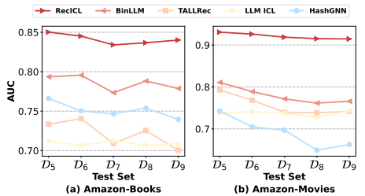
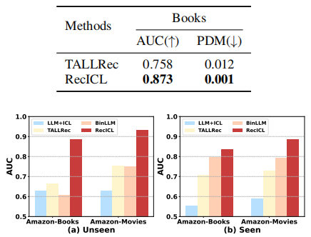
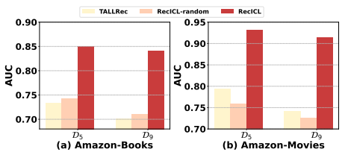
ATAI
Advanced Technique of Artificial Intelligence
ATAI
ChongqingUniversity _{AdvancedTechniqueof}
of Technology Artificial Intelligence
Chongqing University of
Technology
Chongqing University ^{ATAI}
_{of Technology} Advanced Techniqueof
Artificial Intelligence
Chongqing University of Technology
Chongqing University of Technology
Experiments
Notes:
左上：X轴表示实际的数据分区，较大的下标表示与训练集相比用户兴趣的更大转移 ； 左下：在 D5 和 D9 上使用随机选择的少量样本对;
右上：大规模 Amazon Book 数据集（500 万次交互）上的性能; 右下：已见（右）和未见（左）用户的性能比较。

Slide 7


ATAI
Advanced Technique of Artificial Intelligence
ATAI
ChongqingUniversity _{AdvancedTechniqueof}
of Technology Artificial Intelligence
Chongqing University of
Technology
Chongqing University ^{ATAI}
_{of Technology} Advanced Techniqueof
Artificial Intelligence
Chongqing University of Technology
Chongqing University of Technology
Thanks!

